Slide 1
International Environmental Law
Shamshad Ahmad Khan, PhD
Assistant Prof. BPDC

Slide 2
Background
International Environmental law is still in making
It is not a firm law between states as has been the case of the Law of the Seas or Law of Trade etc
The origin of International Law on the Environment could be traced back to the 1972 United Nations Conventions on the Human Environment (UNCHE) held in Stockholm

Slide 3
UNCHE recognized that:
States have a right to exploit their own resources for the well being of their citizens.
States are free to formulate their own environment and development policies to ensure that activities in their jurisdiction do not cause damage to the environment of other states. (Persuade not dictate)

Slide 4
Meanwhile, the concept of Sustainable development also came to existence (1987)
Sustainable development: Development that satisfies the need of present generations without compromising the ability of future generations to meet their own needs.

Slide 5
Three conferences/conventions have played an important role in the evolution of International Environmental law
Rio de Janeiro Earth Summit 1992
Kyoto Protocol 1997
UN Climate Change Conference 2009

Slide 6
Rio Earth Summit
Rio de Janeiro Earth Summit 1992
The 1992 Earth Summit is considered first international summit to give serious consideration to Climate Change.
Established Framework Convention on Climate Change (FCCC). 181 country participate
Called for Green House Gases to be stabilized at safe level
Not legally binding.

Slide 7
Kyoto Protocol
Kyoto Protocol 1997
Set the target (for the period to 2012) for states to cut or limit the target of reducing the emission of greenhouse gases
Target were set for Developed countries NOT developing countries
Targets were legally binding
US (biggest emitter) did not agree (China which over took US in emission in 2008 and India were kept out)

Slide 8
UN Climate Change Conference
UN Climate Change Conference 2009
Kyoto protocol was unable to achieve its success because many industrial countries were not fulfilling its commitment
UN tried to find a solution
United Climate Change Conference was convened in 2009 in Copenhagen
It was the successor to the Kyoto protocol

Slide 9
UN Climate Change Conference
The 2009 Conference (also known as Copenhagen Accord) agreed to “prevent rises in global temperature of more than 2 degree centigrade above pre-industrial levels.”
Failed to create new legally binding obligations on the countries to cut carbon emission.
However, by 2016 UN Climate Change (Paris) was signed in which not only US, but China and India joined and made commitment to control Green gas house emission.

Slide 10
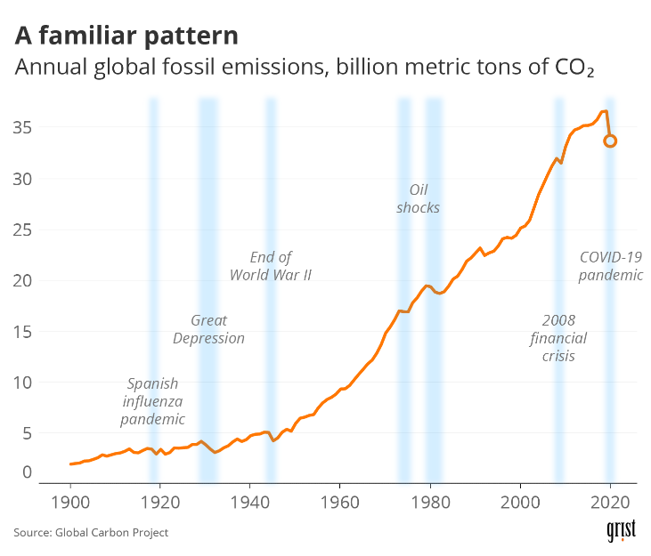
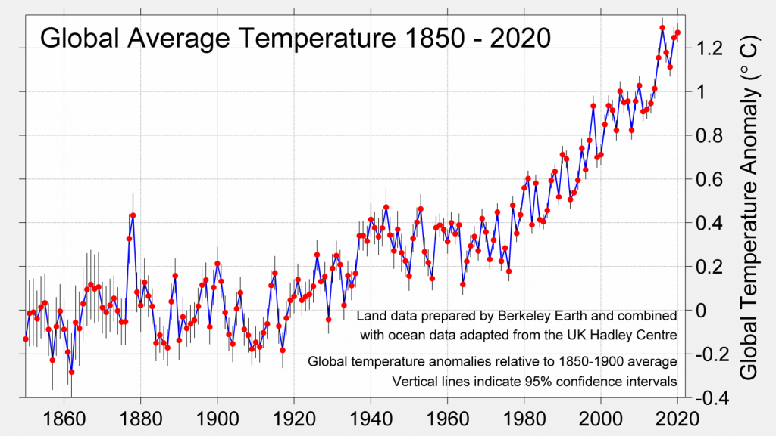
More than 100 countries have pledge carbon net zero.

Slide 11
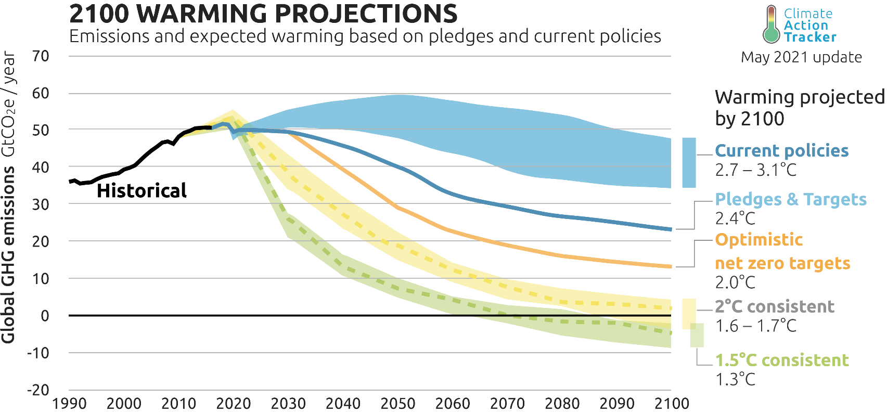
How will it impact on global warming if it is left un-checked?

Slide 12
What is Carbon Net Zero?
https://www.youtube.com/watch?v=3H8iqZxipck

Slide 13
COP 26
Conference of Parties 26th annual meeting (Glasgow)
Major achievements:
Agreement on Cutting Methane Gas emission
Closing down Coal-based power plan (except few countries)
India--- Net Zero by 2070
Not cutting forests (end deforestation by 2030)
Fund African countries to cut Coal-based power plants/energy

Slide 14
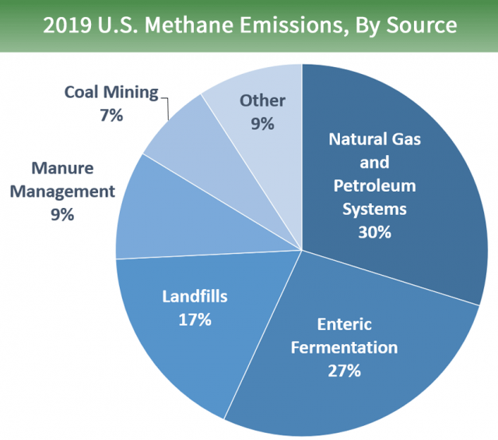
Why Methane Pledge???
Methane, is an extremely potent greenhouse gas.
it has 20 times more warming power in the near-term than carbon dioxide.
The major contributors of methane emissions are livestock, especially by cattle, rice cultivation, and oil and gas pipe lines.
cutting methane emissions was essential to prevent the planet from warming beyond 1.5 degrees Celsius

Slide 15
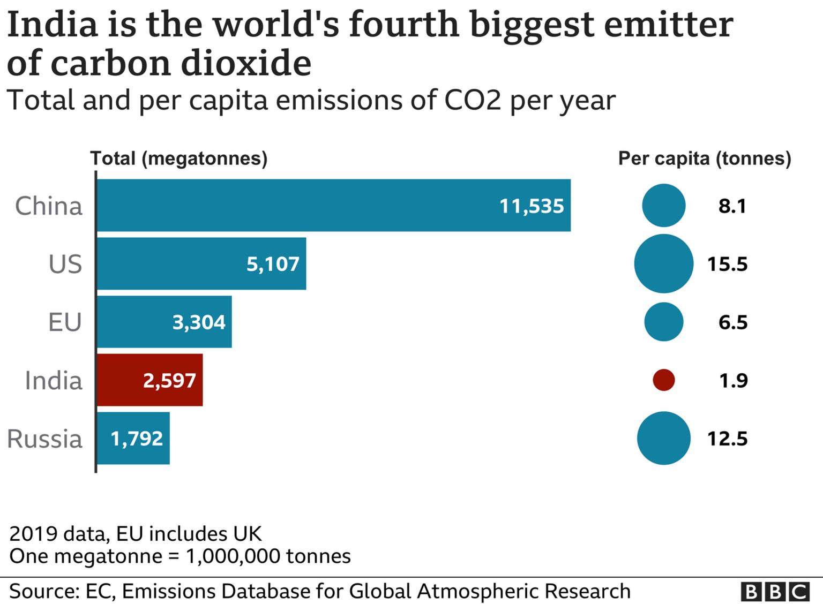

Slide 16
What about India?
Surprise announcement by Indian PM: Net zero by 2070
5 big ticket announcements:
First, India will produce 500 GW of non-fossil fuel energy.
Second, India will have 50 per cent renewable energy in its energy mix.
Third, India will reduce its emissions intensity from 35 per cent to 45 per cent.
Fourth, India’s carbon emissions will be reduced by one billion tonnes. These four actions will be done by 2030.
And, 5th : India will achieve the net-zero target by 2070.
India is now on the same page with 130-odd countries on the fraught issue of net zero emissions (Indian Express, Edit)
https://indianexpress.com/article/opinion/editorials/narendra-modi-at-unfccc-cop26-7604941/

Slide 17
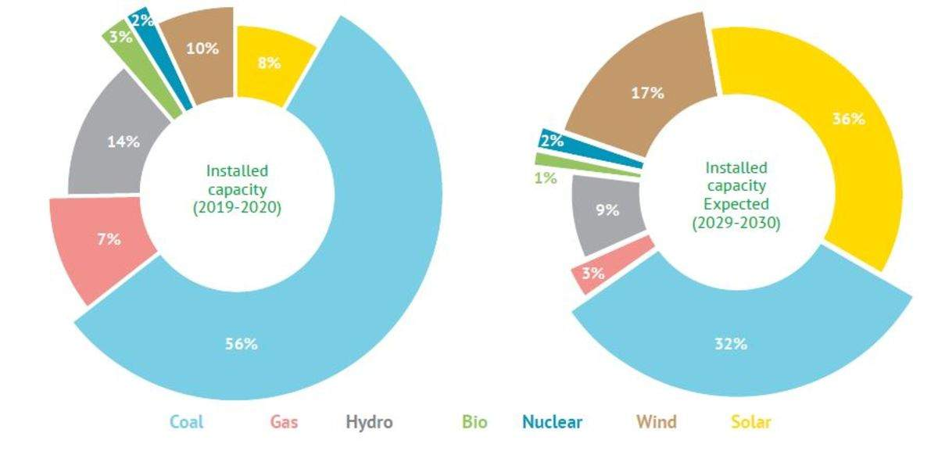
India’s energy mix

Slide 18
International En. Law: A case study of India
India ratified Paris accord in October 2016
responsible for 6% of the global CO2 emissions.
• As part of its commitments to the agreement:
plans to reduce its carbon emission intensity - emission per unit of GDP - by 33-35% from 2005 levels over 15 years.
Aims to produce 40% of its installed electricity capacity by 2030 from non-fossil fuels.

Slide 19
This would mean:
India will shift significantly from coal-based power generation to renewable energy sources.
will have to produce 100 gigawatt from solar, 60 gigawatt from wind, 10 gigawatt from biomass and 5 gigawatt from small hydropower by 2022.

Slide 20
India has to increase its forest cover by five million hectares along with an improvement in the quality of green cover of an equal measure by 2030.

Slide 21
Cop 28
officially acknowledge that fossil fuels are the root cause of climate change.
countries agreed :
“transition away from fossil fuels in energy systems, in a just, orderly and equitable manner, accelerating action in this critical decade, so as to achieve net zero by 2050 in keeping with the science”.

Slide 22
Cop 28
“Loss and damage” :
A fund was agreed at COP27 in 2022 and recent announcements mean USD700 million has been pledged.

Slide 23
COP 28
The “global stocktake”,
finalised at COP28, was the first time the global climate regime took stock of how the international community has collectively reduced its greenhouse gas emissions since the Paris Agreement in 2015.

Slide 24
So what as an individual we can do to achieve Net Zero?
Reduce carbon footprint
Plant few potted plants in your balcony?
(How many of you have some space?)

